Slide 1
Finite Automata

Slide 2
TYPES of FA
DFA
  Deterministic Finite Automata
NFA
  Nondeterministic Finite Automata
NFA-^
  Nondeterministic Finite Automata with ^ transition

Slide 3
TYPES of FA
DFA
  Exact one output transition for each input symbol from each state
NFA
  Multiple output transition and/or missing transition for input symbol is allowed
NFA-^
  Multiple output transition and/or missing transition for input symbol and ^-transitions are allowed

Slide 4
DETERMINISTIC
FINITE
AUTOMATA

Slide 5
Definition of FA
A finite automata or finite-state machine (FA) is a 5 tuple ( Q , ∑ , q₀ , A , δ )
  Q : finite set of states
  ∑ : finite alphabet
  q₀ : initial state (q₀∊Q)
  A : set of accepting states (A⊆Q)
  δ : transition function (from Q×∑ to Q (δ: Q×∑→Q) )

Slide 6
Definition of δ*
δ* is extended transition function
It can be defined as
  δ* : Q×∑* → Q
  For any q∊Q, δ*(q, ᴧ)=q
  For any q∊Q, y∊∑* and a∊∑
  then δ*(q,ya)= δ(δ*(q,y),a)

Slide 7
δ vs. δ*
δ(q,a)
  q : state
  a : input symbol
  δ : give next state after processing input symbol “a”
δ*(q,x)
  q : state
  x : input string
  δ* : give next state after processing input string “x”

Slide 8
δ
b,c
a,c
a,b
a,b,c
a
b
c
0
1
2
3
δ(0,a) = 1 δ(0,b) = 0 δ(0,c) = 0
δ(1,a) = 1 δ(1,b) = 2 δ(1,c) = 1
δ(2,a) = 2 δ(2,b) = 2 δ(2,c) = 3
δ(3,a) = 3 δ(3,b) = 3 δ(3,c) = 3

Slide 9
δ*
b,c
a,c
a,b
a,b,c
a
b
c
0
1
2
3
δ(0,a) = 1
δ(1,b) = 2
δ(2,c) = 3
δ*(0,abc)
  = δ(δ*(0,ab),c)
  = δ(δ(δ*(0,a),b),c)
= δ(δ(δ(δ*(0,ᴧ),a),b),c)
= δ(δ(δ(0,a),b),c)
= δ(δ(1,b),c)
= δ(2,c)
= 3

Slide 10
Definition of Acceptance by an FA
Let M = ( Q , ∑ , q₀ , A , δ ) be an FA
A string x∊∑* is accepted by M if δ*(q₀,x)∊A
If a string is not accepted, we say it is rejected by M
The language accepted / recognized by M is the set L ( M ) = { x∊∑* | x is accepted by M }
If L is any language over ∑, L is accepted by M if and only if L = L ( M )

Slide 11
Theorem - 1
A language L over the alphabet ∑ is regular if and only if there is an FA with input alphabet ∑ that accepts L

Slide 12
Examples
1
0
1
0
1
0
1
0
Ending with 0
(0+1)*0
Even 0
0
1
0
1
1
0
1
1
0
1
0
0
End with 11
End with 10

Slide 13
Examples
1
0
0
1
Not end with 01
0
1
1
0 , 1
0
0
0
1
1
0
1
maximum one occurrence of 00
0
1

Slide 14
Examples
0 ,1
1
0
1
0
1
1
Every 0 immediately
followed by 11
0
0
1
0 , 1
0
0
Not contain 00
1

Slide 15
Examples
Odd 0
Even 1
Even 0
odd 1
0
1
0
1
0
1
0
1
1
0
1
0
1
0
1
0
Even 0
Even 1
odd 0
odd 1
0
1
0
1
0
1
0
1
1
1
0
0
1
0
1
0

Slide 16
Examples
1
0
1
1
0
1
0
0
1
1
0
0
1
1
0
1
0,1
0
0
String has 11 and 010 both

Slide 17
Examples
a
1
0
a
b
0
0
b
a
a
a
b
0
1
b
1
1
b
Next to last 0
End with baaa

Slide 18
Examples
0 , 1
a
a , b
0
0
b
a
1
0
a
a
1
b
b
1
b
Not contain 00
and
End with 1
Must contain either ab or bba

Slide 19
Examples
0 , 1
0
0
1
1
Eight begin or end with
00 or 11
1
0
1
1
1
0
0
0 , 1
1
0
0

Slide 20
Examples
0
0
0
1
1
1
0
1
1
0 , 1
0
( 00 )* ( 11 )*

Slide 21
Examples
1
1
1
1
0 , 1
0 , 1
0
0
0
0
0 , 1
1* 0 1* 0 1*
( 11 + 10 )*
0 , 1
1
1
1
0 , 1
0
0
0
0 , 1
(0+1)* 0 (0+1)* 0 (0+1)*
( 0 + 1 )* ( 1 + 00 ) ( 0 + 1 )*

Slide 22
Examples
0 , 1
1
0
0 , 1
0
0
1
1
0
1
0 , 1
0
1
1
0
1
0
0 , 1
( 111 + 100 )* 0
0 + 10* + 01*0

Slide 23
Examples
0
0
0
0
0 , 1
1
0
1
0 , 1
0
0
1
1
1
0
1
1
1
0
1
1
0
( 0 + 1 )* ( 01 + 110 )
( 11 + 110 )* 0

Slide 24
Examples
1
0
0
1
1
0
1
0
1
0
1
0
1
0
1
0
Binary number divisible by 3
Binary number divisible by 5

Slide 25
Definition of distinguishable string
Let L be a language in ∑*,and x ant string in ∑*
The set L/x is defined as follow
L/x = { z∊∑* | xz∊L }
Two strings x and y are said to be distinguishable with respect to L
if L/x ≠ L/y
i.e. For any string z
xz∊L and yz∊L or vice versa

Slide 26
Definition of indistinguishable string
If L/x = L/y , x and y are indistinguishable string with respect to L

Slide 27
Lemma-1
Suppose L⊆∑* and M=( Q , ∑ , q₀ , A , δ ) is an FA recognizing L
If x and y are two strings in ∑* that are distinguishable with respect to L then
δ*(q₀,x)≠δ*(q₀,y)

Slide 28
Theorem - 2
Suppose L⊆∑* and for some positive integer n there are n strings in ∑* any two of which are distinguishable with respect to L
Then every FA recognizing L must have at least n states

Slide 29
Theorem - 3
The language pal of palindromes over the alphabet {0,1} cannot be accepted by any finite automaton, and it is therefore not regular

Slide 30
Union, intersection, complement
L₁ and L₂ are to languages then we can find
  L₁ ∪ L₂
  L₁ ∩ L₂
  L₁ - L₂

Slide 31
Theorem - 4
Suppose M₁= (Q₁ , ∑ , q₁ , A₁ , δ₁) and M₂= (Q₂ , ∑ , q₂ , A₂ , δ₂) accept language L₁ and L₂ respectively.
Let M be the FA defined by M= (Q , ∑ , q₀ , A , δ) where
Q = Q₁ × Q₂
q₀ = ( q₁ , q₂ )
and the transition function δ is defined by the
formula

Slide 32
Theorem - 4
δ ( ( p,q ) , a ) = ( δ₁ ( p,a ) , δ₂ ( q,a ) )
(for any p ∊ Q₁ , q ∊ Q₂ and a ∊ ∑)
If A = {(p,q) | p ∊ A₁ or q ∊ A₂},
M accept language L₁∪L₂
If A = {(p,q) | p ∊ A₁ and q ∊ A₂},
M accept language L₁∩L₂
If A = {(p,q) | p ∊ A₁ or q ∉ A₂},
M accept language L₁ - L₂

Slide 33
Example-1
L1 = { x | 00 is not a substring }
L2 = { x | x ends with 01}

Slide 34
Example-1
L1 = { x | 00 is not a substring }
L2 = { x | x ends with 01}
  Step-1 : prepare FA for both languages

Slide 35
Example-1
L1 = { x | 00 is not a substring }
L2 = { x | x ends with 01}
  Step-1 : prepare FA for both languages
1
0
1
0 , 1
0
1
A
0
B
0
C
P
Q
R
0
1
1
L₁
L₂

Slide 36
Example-1
  Step-2 : make combination of states of L₁ and L₂ and make transaction table for it
1
0 , 1
A
0
B
0
C
1
1
0
0
1
P
Q
R
0
1

Slide 37
Example-1
  Step-2 : make combination of states of L₁ and L₂ and make transaction table for it
 | 0 | 1
AP | BQ | AP
AQ | BQ | AR
AR | BQ | AP
BP | CQ | AP
BQ | CQ | AR
BR | CQ | AP
CP | CQ | CP
CQ | CQ | CR
CR | CQ | CP
1
0 , 1
A
0
B
0
C
1
1
0
0
1
P
Q
R
0
1

Slide 38
Example-1
  Step-3 : make FA from given transition table
 | 0 | 1
AP | BQ | AP
AQ | BQ | AR
AR | BQ | AP
BP | CQ | AP
BQ | CQ | AR
BR | CQ | AP
CP | CQ | CP
CQ | CQ | CR
CR | CQ | CP

Slide 39
Example-1
  Step-3 : make FA from given transition table
1
1
 | 0 | 1
AP | BQ | AP
AQ | BQ | AR
AR | BQ | AP
BP | CQ | AP
BQ | CQ | AR
BR | CQ | AP
CP | CQ | CP
CQ | CQ | CR
CR | CQ | CP
AP
1
BP
CP
1
0
0
0
0
1
AQ
0
BQ
0
CQ
1
1
0
0
0
1
1
AR
BR
CR

Slide 40
Example-1
  Step-4 : select initial state
  (initial state L₁ is A and L₂ is P so here initial state is AP)
1
1
AP
1
BP
CP
1
0
0
0
0
1
AQ
0
BQ
0
CQ
1
1
0
0
0
1
1
AR
BR
CR

Slide 41
Example-1
  Step-5 : Remove all states (with their transitions) which are not having incoming edges (never remove initial state)
1
1
AP
1
BP
CP
1
0
0
0
0
1
AQ
0
BQ
0
CQ
1
1
0
0
0
1
1
AR
BR
CR

Slide 42
Example-1
  Step-5 : Remove all states (with their transitions) which are not having incoming edges (never remove initial state)
1
1
AP
CP
0
0
0
1
BQ
0
CQ
1
0
0
1
1
AR
CR

Slide 43
Example-1
  Step-6 : apply following rule to identify accepting states
L₁ ∪ L₂ | Accepting states of L₁ with all states of L₂ & Accepting states of L₂ with all states of L₁
L₁ ∩ L₂ | Accepting states of L₁ with Accepting states of L₂
L₁ - L₂ | Accepting states of L₁ with non accepting states of L₂

Slide 44
Example-1
  Step-6 : apply following rule to identify accepting states
L₁ ∪ L₂ | Accepting states of L₁ with all states of L₂ & Accepting states of L₂ with all states of L₁ AP , AQ , AR , BP , BQ , BR , RA , RB , RC
L₁ ∩ L₂ | Accepting states of L₁ with Accepting states of L₂ AR , BR
L₁ - L₂ | Accepting states of L₁ with non accepting states of L₂ AP , AQ , BP , BQ

Slide 45
Example-1
  Step-6 : apply following rule to identify accepting states
L₁ ∪ L₂ | Accepting states of L₁ with all states of L₂ & Accepting states of L₂ with all states of L₁ AP , AQ , AR , BP , BQ , BR , RA , RB , RC
L₁ ∩ L₂ | Accepting states of L₁ with Accepting states of L₂ AR , BR
L₁ - L₂ | Accepting states of L₁ with non accepting states of L₂ AP , AQ , BP , BQ
Remove
RA & RB
as
RA=AR
&
RB=BR

Slide 46
Example-1
  Step-6 : apply following rule to identify accepting states
L₁ ∪ L₂ | Accepting states of L₁ with all states of L₂ & Accepting states of L₂ with all states of L₁ AP , AQ , AR , BP , BQ , BR , RC
L₁ ∩ L₂ | Accepting states of L₁ with Accepting states of L₂ AR , BR
L₁ - L₂ | Accepting states of L₁ with non accepting states of L₂ AP , AQ , BP , BQ

Slide 47
Example-1
  Step-6 : apply following rule to identify accepting states
L₁ ∪ L₂ | Accepting states of L₁ with all states of L₂ & Accepting states of L₂ with all states of L₁ AP , AQ , AR , BP , BQ , BR , RC
L₁ ∩ L₂ | Accepting states of L₁ with Accepting states of L₂ AR , BR
L₁ - L₂ | Accepting states of L₁ with non accepting states of L₂ AP , AQ , BP , BQ
Remove
AQ , BP , BR
as
they are
not part
of final
FA

Slide 48
Example-1
  Step-6 : apply following rule to identify accepting states
L₁ ∪ L₂ | Accepting states of L₁ with all states of L₂ & Accepting states of L₂ with all states of L₁ AP , AR , BQ , RC
L₁ ∩ L₂ | Accepting states of L₁ with Accepting states of L₂ AR
L₁ - L₂ | Accepting states of L₁ with non accepting states of L₂ AP , BQ

Slide 49
Example-1
  Step-7 : make individual diagram for
  L₁∪L₂ , L₁∩L₂ , L₁-L₂ ( with accepting states)

Slide 50
Example-1
  Step-7 : make individual diagram for
  L₁∪L₂ , L₁∩L₂ , L₁-L₂ ( with accepting states)
1
1
AP
CP
0
L₁∪L₂
0
0
1
BQ
0
CQ
1
0
0
1
1
AR
CR

Slide 51
Example-1
  Step-7 : make individual diagram for
  L₁∪L₂ , L₁∩L₂ , L₁-L₂ ( with accepting states)
1
1
AP
CP
0
L₁∩L₂
0
0
1
BQ
0
CQ
1
0
0
1
1
AR
CR

Slide 52
Example-1
  Step-7 : make individual diagram for
  L₁∪L₂ , L₁∩L₂ , L₁-L₂ ( with accepting states)
1
1
AP
CP
0
L₁-L₂
0
0
1
BQ
0
CQ
1
0
0
1
1
AR
CR

Slide 53
Example-2
Find L₁ ∪ L₂ , L₁ ∩ L₂ , L₁ - L₂ , L₁ ∩ L₃ , L₃ - L₂
1
0
0,1
0
A
0
B
1
C
X
1
Y
1
Z
0
1
0
L₁
L₂
0,1
R
S
0,1
L₃

Slide 54
NONDETERMINISTIC
FINITE
AUTOMATA

Slide 55
Definition of NFA
A nondeterministic finite automata(NFA) is a 5 tuple M = ( Q , ∑ , q₀ , A , δ )
  Q : finite set of states
  ∑ : finite alphabet
  q₀ : initial state (q₀∊Q)
  A : set of accepting states (A⊆Q)
  δ : transition function ( δ: Q×∑→2^{Q} )

Slide 56
Definition of δ*
δ* is extended transition function
It can be defined as
  δ* : Q × ∑* → 2^{Q}
  For any q∊Q, δ*(q, ᴧ) = {q}
  For any q∊Q, y∊∑* and a∊∑
  then δ*(q,ya) = ∪ δ(r,a)
  r∊δ*(q,y)

Slide 57
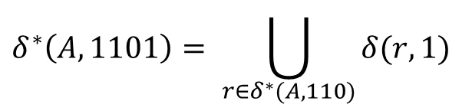
δ*
0,1
1
0,1
0,1
A
B
C
D
$$δ^{∗}\left(A,1101\right)= \bigcup_{r∈δ^{∗}(A,110)}{δ(r,1)}$$

Slide 58
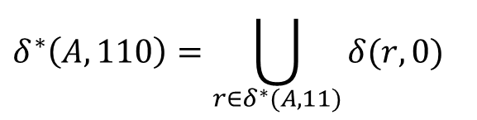
δ*
0,1
1
0,1
0,1
A
B
C
D
$$δ^{∗}\left(A,1101\right)= \bigcup_{r∈δ^{∗}(A,110)}{δ(r,1)}$$
$$δ^{∗}\left(A,110\right)=\bigcup_{r∈δ^{∗}(A,11)}{δ(r,0)}$$

Slide 59
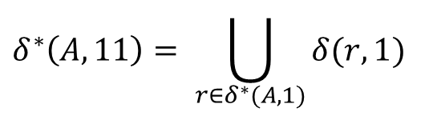
δ*
0,1
1
0,1
0,1
A
B
C
D
$$δ^{∗}\left(A,1101\right)= \bigcup_{r∈δ^{∗}(A,110)}{δ(r,1)}$$
$$δ^{∗}\left(A,110\right)=\bigcup_{r∈δ^{∗}(A,11)}{δ(r,0)}$$
$$δ^{∗}\left(A,11\right)= \bigcup_{r∈δ^{∗}(A,1)}{δ(r,1)}$$

Slide 60
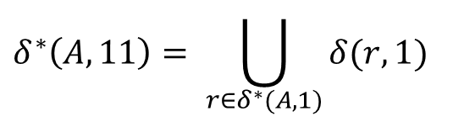
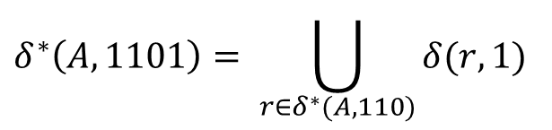
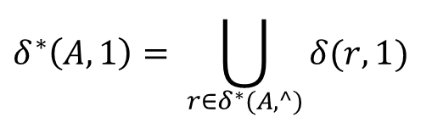
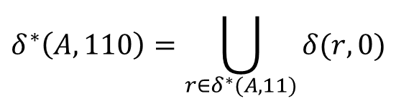
δ*
0,1
1
0,1
0,1
A
B
C
D
$$δ^{∗}\left(A,1101\right)= \bigcup_{r∈δ^{∗}(A,110)}{δ(r,1)}$$
$$δ^{∗}\left(A,110\right)=\bigcup_{r∈δ^{∗}(A,11)}{δ(r,0)}$$
$$δ^{∗}\left(A,11\right)= \bigcup_{r∈δ^{∗}(A,1)}{δ(r,1)}$$
$$δ^{∗}\left(A,1\right)= \bigcup_{r∈δ^{∗}(A,^)}{δ(r,1)}$$

Slide 61
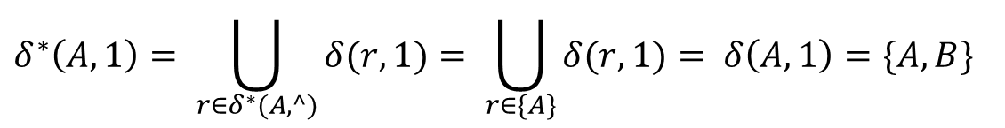
δ*
0,1
1
0,1
0,1
A
B
C
D
$$δ^{∗}\left(A,1101\right)= \bigcup_{r∈δ^{∗}(A,110)}{δ(r,1)}$$
$$δ^{∗}\left(A,110\right)=\bigcup_{r∈δ^{∗}(A,11)}{δ(r,0)}$$
$$δ^{∗}\left(A,11\right)= \bigcup_{r∈δ^{∗}(A,1)}{δ(r,1)}$$
$$δ^{∗}\left(A,1\right)= \bigcup_{r∈δ^{∗}(A,^)}{δ(r,1)}= \bigcup_{r∈\{A\}}{δ(r,1)}= δ\left(A,1\right)=\{A,B\}$$

Slide 62
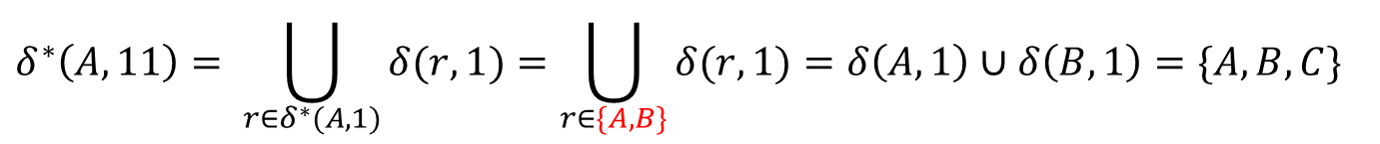
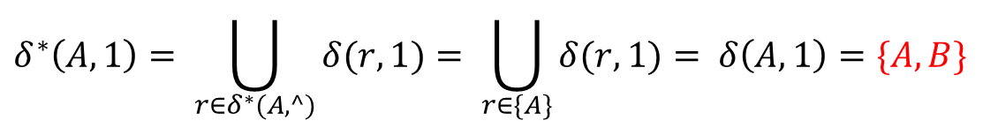
δ*
0,1
1
0,1
0,1
A
B
C
D
$$δ^{∗}\left(A,1101\right)= \bigcup_{r∈δ^{∗}(A,110)}{δ(r,1)}$$
$$δ^{∗}\left(A,110\right)=\bigcup_{r∈δ^{∗}(A,11)}{δ(r,0)}$$
$$δ^{∗}\left(A,11\right)= \bigcup_{r∈δ^{∗}(A,1)}{δ(r,1)}=\bigcup_{r∈\{A,B\}}{δ(r,1)}=δ\left(A,1\right)∪δ\left(B,1\right)=\{A,B,C\}$$
$$δ^{∗}\left(A,1\right)= \bigcup_{r∈δ^{∗}(A,^)}{δ(r,1)}= \bigcup_{r∈\{A\}}{δ(r,1)}= δ\left(A,1\right)=\{A,B\}$$

Slide 63
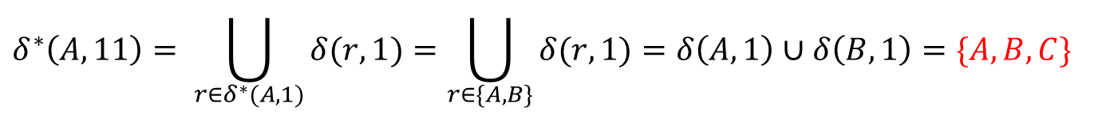

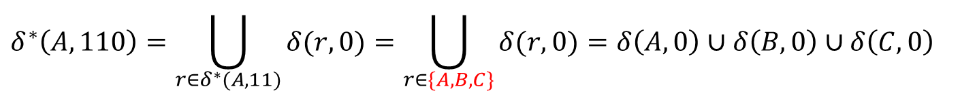
δ*
0,1
1
0,1
0,1
A
B
C
D
$$δ^{∗}\left(A,1101\right)= \bigcup_{r∈δ^{∗}(A,110)}{δ(r,1)}$$
$$δ^{∗}\left(A,110\right)=\bigcup_{r∈δ^{∗}(A,11)}{δ(r,0)}=\bigcup_{r∈\{A,B,C\}}{δ(r,0)}=δ\left(A,0\right)∪δ\left(B,0\right)∪δ\left(C,0\right)$$
$$=\{C,D,A\}$$
$$δ^{∗}\left(A,11\right)= \bigcup_{r∈δ^{∗}(A,1)}{δ(r,1)}=\bigcup_{r∈\{A,B\}}{δ(r,1)}=δ\left(A,1\right)∪δ\left(B,1\right)=\{A,B,C\}$$
$$δ^{∗}\left(A,1\right)= \bigcup_{r∈δ^{∗}(A,^)}{δ(r,1)}= \bigcup_{r∈\{A\}}{δ(r,1)}= δ\left(A,1\right)=\{A,B\}$$

Slide 64
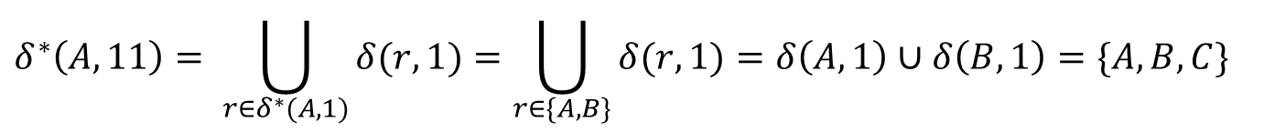


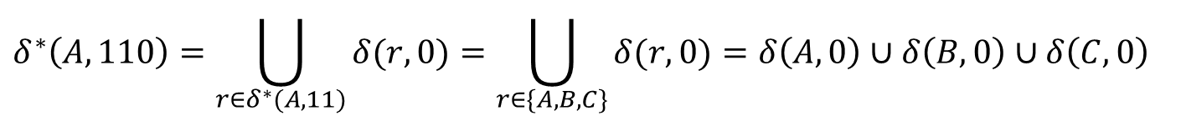
δ*
0,1
1
0,1
0,1
A
B
C
D
$$δ^{∗}\left(A,1101\right)= \bigcup_{r∈δ^{∗}(A,110)}{δ(r,1)=\bigcup_{r∈\{C,D,A\}}{δ(r,1)}=δ\left(C,1\right)∪δ\left(D,1\right)∪δ\left(A,1\right) }$$
$$=\{D,A,B\}$$
$$δ^{∗}\left(A,110\right)=\bigcup_{r∈δ^{∗}(A,11)}{δ(r,0)}=\bigcup_{r∈\{A,B,C\}}{δ(r,0)}=δ\left(A,0\right)∪δ\left(B,0\right)∪δ\left(C,0\right)$$
$$=\{C,D,A\}$$
$$δ^{∗}\left(A,11\right)= \bigcup_{r∈δ^{∗}(A,1)}{δ(r,1)}=\bigcup_{r∈\{A,B\}}{δ(r,1)}=δ\left(A,1\right)∪δ\left(B,1\right)=\{A,B,C\}$$
$$δ^{∗}\left(A,1\right)= \bigcup_{r∈δ^{∗}(A,^)}{δ(r,1)}= \bigcup_{r∈\{A\}}{δ(r,1)}= δ\left(A,1\right)=\{A,B\}$$

Slide 65


δ*
0,1
1
0,1
0,1
A
B
C
D
$$δ^{∗}\left(A,1101\right)= \bigcup_{r∈δ^{∗}(A,110)}{δ(r,1)=\bigcup_{r∈\{C,D,A\}}{δ(r,1)}=δ\left(C,1\right)∪δ\left(D,1\right)∪δ\left(A,1\right) }$$
$$=\{D,A,B\}$$
Final answer
$$δ^{∗}\left(A,110\right)=\bigcup_{r∈δ^{∗}(A,11)}{δ(r,0)}=\bigcup_{r∈\{A,B,C\}}{δ(r,0)}=δ\left(A,0\right)∪δ\left(B,0\right)∪δ\left(C,0\right)$$
$$=\{C,D,A\}$$
$$δ^{∗}\left(A,11\right)= \bigcup_{r∈δ^{∗}(A,1)}{δ(r,1)}=\bigcup_{r∈\{A,B\}}{δ(r,1)}=δ\left(A,1\right)∪δ\left(B,1\right)=\{A,B,C\}$$
$$δ^{∗}\left(A,1\right)= \bigcup_{r∈δ^{∗}(A,^)}{δ(r,1)}= \bigcup_{r∈\{A\}}{δ(r,1)}= δ\left(A,1\right)=\{A,B\}$$

Slide 66
Definition of Acceptance by an NFA
Let M = ( Q , ∑ , q₀ , A , δ ) be an NFA
A string x∊∑* is accepted by M if δ*(q₀,x)∩A≠∅
The language accepted / recognized by M is the set L ( M ) of all strings accepted by M
For any language L ⊆ ∑*,L is recognized by M
if L = L ( M )

Slide 67
Theorem - 5
For any NFA
M = { Q , ∑ , q₀ , A , δ } accepting a language
L ⊆ ∑*, there is an FA M₁ = {Q ₁, ∑ , q₁ , A₁ , δ₁ }
that also accepts L

Slide 68
NFA to DFA conversion
b
1
a
2
a
3
a
b
4
b
5
a
NFA

Slide 69
NFA to DFA conversion
b
Prepare transition table for FA
Two input symbols a&b
Start with initial state 1
1
a
2
a
3
a
b
4
b
5
a
NFA

Slide 70
NFA to DFA conversion
b
Prepare transition table for FA
Two input symbols a&b
Start with initial state 1
1
a
2
a
3
a
b
b
 | a | b
1
4
5
a
NFA

Slide 71


NFA to DFA conversion
b
1
a
2
a
3
a
b
b
 | a | b
1
4
5
a
NFA
$$δ^{∗}\left(1,a\right)$$
$$δ^{∗}\left(1,b\right)$$

Slide 72
NFA to DFA conversion
b
1
a
2
a
3
a
b
b
 | a | b
1 | 2 | ∅
4
5
a
NFA
$$δ^{∗}\left(1,a\right)$$
$$δ^{∗}\left(1,b\right)$$

Slide 73
NFA to DFA conversion
b
Two new states encounter
2 and ∅
Add them
1
a
2
a
3
a
b
b
 | a | b
1 | 2 | ∅
2
∅
4
5
a
NFA

Slide 74


NFA to DFA conversion
b
1
a
2
a
3
a
b
b
 | a | b
1 | 2 | ∅
2 | 3,4 | 5
∅
4
5
a
NFA
$$δ^{∗}\left(2,a\right)$$
$$δ^{∗}\left(2,b\right)$$

Slide 75
NFA to DFA conversion
b
Two new states encounter
3,4 and 5
Add them
1
a
2
a
3
a
b
b
 | a | b
1 | 2 | ∅
2 | 3,4 | 5
∅
3,4
5
4
5
a
NFA

Slide 76


NFA to DFA conversion
b
1
a
2
a
3
a
b
b
 | a | b
1 | 2 | ∅
2 | 3,4 | 5
∅ | ∅ | ∅
3,4
5
4
5
a
NFA
$$δ^{∗}\left(\text{∅},a\right)$$
$$δ^{∗}\left(\text{∅},b\right)$$

Slide 77


NFA to DFA conversion
b
1
a
2
a
3
a
b
b
 | a | b
1 | 2 | ∅
2 | 3,4 | 5
∅ | ∅ | ∅
3,4 | 4 | 3,5
5
4
5
a
NFA
$$δ^{∗}\left(\text{\{3,4\}},a\right)$$
$$δ^{∗}\left(\text{\{3,4\}},b\right)$$

Slide 78
NFA to DFA conversion
b
Two new states encounter
4 and 3,5
Add them
1
a
2
a
3
a
b
b
 | a | b
1 | 2 | ∅
2 | 3,4 | 5
∅ | ∅ | ∅
3,4 | 4 | 3,5
5
4
3,5
4
5
a
NFA

Slide 79


NFA to DFA conversion
b
1
a
2
a
3
a
b
b
 | a | b
1 | 2 | ∅
2 | 3,4 | 5
∅ | ∅ | ∅
3,4 | 4 | 3,5
5 | ∅ | ∅
4
3,5
4
5
a
NFA
$$δ^{∗}\left(\text{5},a\right)$$
$$δ^{∗}\left(\text{5},b\right)$$

Slide 80


NFA to DFA conversion
b
1
a
2
a
3
a
b
b
 | a | b
1 | 2 | ∅
2 | 3,4 | 5
∅ | ∅ | ∅
3,4 | 4 | 3,5
5 | ∅ | ∅
4 | 4 | 5
3,5
4
5
a
NFA
$$δ^{∗}\left(4,a\right)$$
$$δ^{∗}\left(\text{4},b\right)$$

Slide 81


NFA to DFA conversion
b
1
a
2
a
3
a
b
b
 | a | b
1 | 2 | ∅
2 | 3,4 | 5
∅ | ∅ | ∅
3,4 | 4 | 3,5
5 | ∅ | ∅
4 | 4 | 5
3,5 | ∅ | 3
4
5
a
NFA
$$δ^{∗}\left(\{3,5\},a\right)$$
$$δ^{∗}\left(\{3,5\},b\right)$$

Slide 82
NFA to DFA conversion
b
One new state encounter 3
Add it
1
a
2
a
3
a
b
b
 | a | b
1 | 2 | ∅
2 | 3,4 | 5
∅ | ∅ | ∅
3,4 | 4 | 3,5
5 | ∅ | ∅
4 | 4 | 5
3,5 | ∅ | 3
3
4
5
a
NFA

Slide 83


NFA to DFA conversion
b
One new state encounter 3
Add it
1
a
2
a
3
a
b
b
 | a | b
1 | 2 | ∅
2 | 3,4 | 5
∅ | ∅ | ∅
3,4 | 4 | 3,5
5 | ∅ | ∅
4 | 4 | 5
3,5 | ∅ | 3
3 | ∅ | 3
4
5
a
NFA
$$δ^{∗}\left(3,a\right)$$
$$δ^{∗}\left(3,b\right)$$

Slide 84
NFA to DFA conversion
b
No new state encounter
So stop & prepare FA for it
1
a
2
a
3
a
b
b
 | a | b
1 | 2 | ∅
2 | 3,4 | 5
∅ | ∅ | ∅
3,4 | 4 | 3,5
5 | ∅ | ∅
4 | 4 | 5
3,5 | ∅ | 3
3 | ∅ | 3
4
5
a
NFA

Slide 85
NFA to DFA conversion
1
a
2
a
3,4
b
b
a,b
∅
a,b
5
a
 | a | b
1 | 2 | ∅
2 | 3,4 | 5
∅ | ∅ | ∅
3,4 | 4 | 3,5
5 | ∅ | ∅
4 | 4 | 5
3,5 | ∅ | 3
3 | ∅ | 3
b
a
a
3,5
b
3
4
b
a
b

Slide 86
NFA to DFA conversion
1
a
2
a
3,4
Initial state of NFA
will be the
initial state for FA
So 1 will be
the initial state
b
b
a,b
∅
a,b
5
a
b
a
a
3,5
b
3
4
b
a
b

Slide 87
NFA to DFA conversion
1
a
2
a
3,4
Accepting states of
NFA was 3 and 5
All states of FA
containing any
one of them will be
the accepting state
So 3,4 5 3,5 3 will be
The accepting states
b
b
a,b
∅
a,b
5
a
b
a
a
3,5
b
3
4
b
a
b

Slide 88
NFA to DFA conversion
1
a
2
a
3,4
b
b
a,b
∅
a,b
5
a
b
a
a
3,5
b
3
4
b
a
DFA
b

Slide 89
NONDETERMINISTIC
FINITE
AUTOMATA
WITH
^ - TRANSITION

Slide 90
Definition of NFA-^
A nondeterministic finite automata with ^-transition (NFA-^) is a 5 tuple
M = ( Q , ∑ , q₀ , A , δ )
  Q : finite set of states
  ∑ : finite alphabet
  q₀ : initial state (q₀∊Q)
  A : set of accepting states (A⊆Q)
  δ : transition function ( δ: Q × ( ∑∪{^} ) →2^{Q} )

Slide 91
ʌ - closer of a set of states
Let M = ( Q , ∑ , q₀ , A , δ ) be an NFA-ʌ and let S be any subset of Q
The ʌ - closer of S is the set ʌ(S) defined as follows
  every element of S is an element of ʌ(S)
  For any q∊ʌ(S) every element of δ(q,ʌ) is in ʌ(S)
  No other element of Q are in ʌ(S)

Slide 92
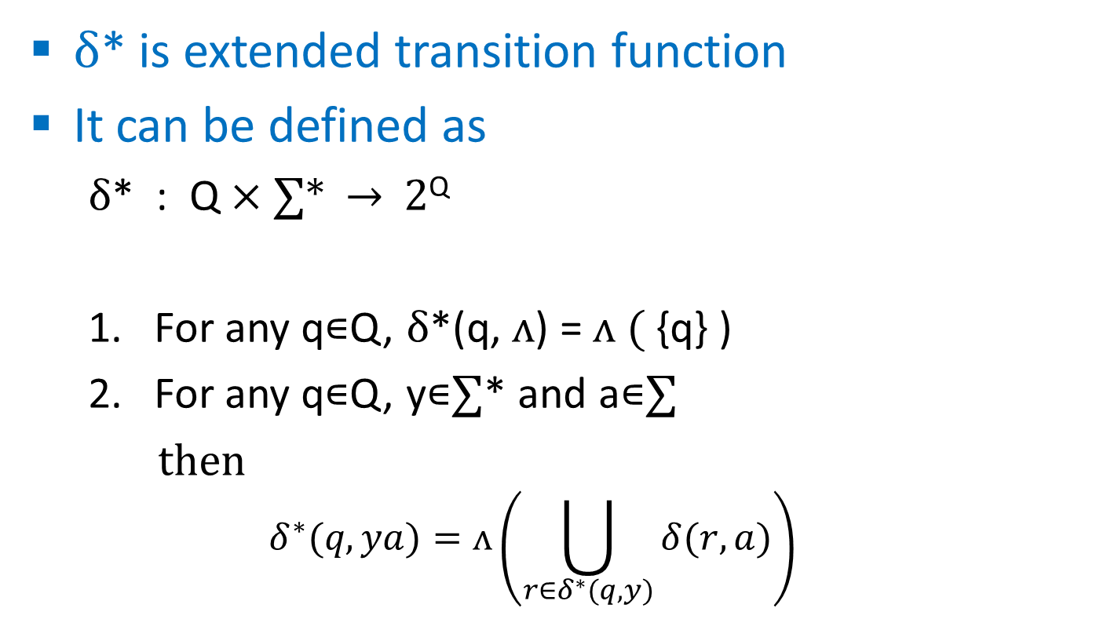
Definition of δ*
δ* is extended transition function
It can be defined as
  δ* : Q × ∑* → 2^{Q}
  For any q∊Q, δ*(q, ᴧ) = ᴧ ( {q} )
  For any q∊Q, y∊∑* and a∊∑
  then
  $$δ^{∗}(q,ya)=\text{ᴧ}\left(\bigcup_{r∈δ^{∗}(q,y)}{δ(r,a)}\right)$$

Slide 93
δ*
0
C
0
0
1
A
^
B
^
D

Slide 94
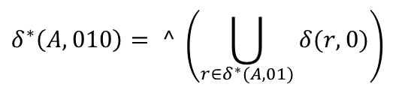
δ*
0
C
0
0
1
A
^
B
^
D
$$δ^{∗}\left(A,010\right)= ^ \left(\bigcup_{r∈δ^{∗}(A,01)}{δ(r,0)}\right)$$

Slide 95
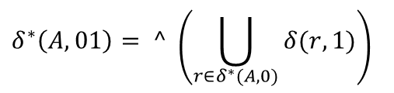
δ*
0
C
0
0
1
A
^
B
^
D
$$δ^{∗}\left(A,010\right)= ^ \left(\bigcup_{r∈δ^{∗}(A,01)}{δ(r,0)}\right)$$
$$δ^{∗}\left(A,01\right)= ^ \left(\bigcup_{r∈δ^{∗}(A,0)}{δ(r,1)}\right)$$

Slide 96
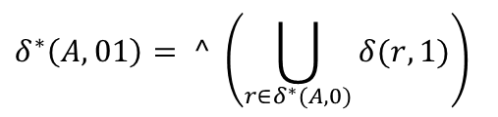
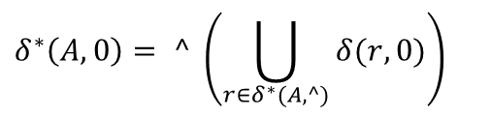
δ*
0
C
0
0
1
A
^
B
^
D
$$δ^{∗}\left(A,010\right)= ^ \left(\bigcup_{r∈δ^{∗}(A,01)}{δ(r,0)}\right)$$
$$δ^{∗}\left(A,01\right)= ^ \left(\bigcup_{r∈δ^{∗}(A,0)}{δ(r,1)}\right)$$
$$δ^{∗}\left(A,0\right)= ^ \left(\bigcup_{r∈δ^{∗}(A,^)}{δ(r,0)}\right)$$

Slide 97
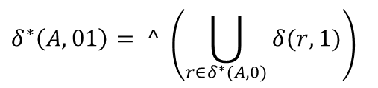

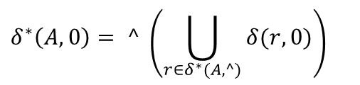
δ*
0
C
0
0
1
A
^
B
^
D
$$δ^{∗}\left(A,010\right)= ^ \left(\bigcup_{r∈δ^{∗}(A,01)}{δ(r,0)}\right)$$
$$δ^{∗}\left(A,01\right)= ^ \left(\bigcup_{r∈δ^{∗}(A,0)}{δ(r,1)}\right)$$
$$δ^{∗}\left(A,0\right)= ^ \left(\bigcup_{r∈δ^{∗}(A,^)}{δ(r,0)}\right)$$
$$δ^{∗}\left(A,^\right)= ^ \left(\{A\}\right)$$

Slide 98

δ*
0
C
0
0
1
A
^
B
^
D
$$δ^{∗}\left(A,010\right)= ^ \left(\bigcup_{r∈δ^{∗}(A,01)}{δ(r,0)}\right)$$
$$δ^{∗}\left(A,01\right)= ^ \left(\bigcup_{r∈δ^{∗}(A,0)}{δ(r,1)}\right)$$
$$δ^{∗}\left(A,0\right)= ^ \left(\bigcup_{r∈δ^{∗}(A,^)}{δ(r,0)}\right)$$
$$δ^{∗}\left(A,^\right)= ^ \left(\{A\}\right)$$
$=${A , B , D}

Slide 99

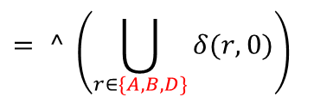


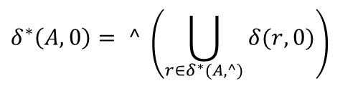

δ*
0
C
0
0
1
A
^
B
^
D
$$δ^{∗}\left(A,010\right)= ^ \left(\bigcup_{r∈δ^{∗}(A,01)}{δ(r,0)}\right)$$
$$δ^{∗}\left(A,01\right)= ^ \left(\bigcup_{r∈δ^{∗}(A,0)}{δ(r,1)}\right)$$
$$δ^{∗}\left(A,0\right)= ^ \left(\bigcup_{r∈δ^{∗}(A,^)}{δ(r,0)}\right)$$
$$= ^ \left(\bigcup_{r∈\{A,B,D\}}{δ(r,0)}\right)$$
$$= ^ \left(δ\left(A,0\right)∪ δ\left(B,0\right)∪ δ\left(D,0\right)\right)$$
$$= ^ \left(\{A,C,D\}\right)$$
$$=\{A,B,C,D\}$$
$$δ^{∗}\left(A,^\right)= ^ \left(\{A\}\right)$$
$=${A,B,D}

Slide 100
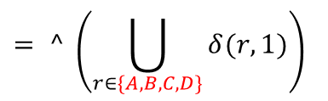
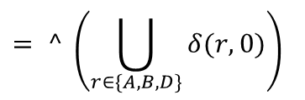




δ*
0
C
0
0
1
A
^
B
^
D
$$δ^{∗}\left(A,010\right)= ^ \left(\bigcup_{r∈δ^{∗}(A,01)}{δ(r,0)}\right)$$
$$δ^{∗}\left(A,01\right)= ^ \left(\bigcup_{r∈δ^{∗}(A,0)}{δ(r,1)}\right)$$
$$= ^ \left(\bigcup_{r∈\{A,B,C,D\}}{δ(r,1)}\right)$$
$$= ^ \left(\begin{aligned}δ\left(A,1\right)∪δ\left(B,1\right)∪δ\left(C,1\right) \\ ∪δ\left(D,1\right)\end{aligned}\right)$$
$$= ^ \left(\{B\}\right)$$
$$=\{B,D\}$$
$$δ^{∗}\left(A,0\right)= ^ \left(\bigcup_{r∈δ^{∗}(A,^)}{δ(r,0)}\right)$$
$$= ^ \left(\bigcup_{r∈\{A,B,D\}}{δ(r,0)}\right)$$
$$= ^ \left(δ\left(A,0\right)∪ δ\left(B,0\right)∪ δ\left(D,0\right)\right)$$
$$= ^ \left(\{A,C,D\}\right)$$
$$=\{A,B,C,D\}$$
$$δ^{∗}\left(A,^\right)= ^ \left(\{A\}\right)$$
$=${A , B , D}

Slide 101
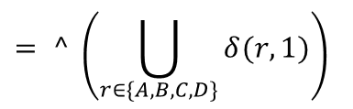





δ*
0
C
0
0
1
A
^
B
^
D
$$δ^{∗}\left(A,010\right)= ^ \left(\bigcup_{r∈δ^{∗}(A,01)}{δ(r,0)}\right)$$
$$= ^ \left(\bigcup_{r∈\{B,D\}}{δ(r,0)}\right)$$
$$= ^ \left(δ\left(B,0\right)∪δ\left(D,0\right)\right)$$
$$= ^ \left(\{C,D\}\right)$$
$$=\{C,D\}$$
$$δ^{∗}\left(A,01\right)= ^ \left(\bigcup_{r∈δ^{∗}(A,0)}{δ(r,1)}\right)$$
$$= ^ \left(\bigcup_{r∈\{A,B,C,D\}}{δ(r,1)}\right)$$
$$= ^ \left(\begin{aligned}δ\left(A,1\right)∪δ\left(B,1\right)∪δ\left(C,1\right) \\ ∪δ\left(D,1\right)\end{aligned}\right)$$
$$= ^ \left(\{B\}\right)$$
$$=\{B,D\}$$
$$δ^{∗}\left(A,0\right)= ^ \left(\bigcup_{r∈δ^{∗}(A,^)}{δ(r,0)}\right)$$
$$= ^ \left(\bigcup_{r∈\{A,B,D\}}{δ(r,0)}\right)$$
$$= ^ \left(δ\left(A,0\right)∪ δ\left(B,0\right)∪ δ\left(D,0\right)\right)$$
$$= ^ \left(\{A,C,D\}\right)$$
$$=\{A,B,C,D\}$$
$$δ^{∗}\left(A,^\right)= ^ \left(\{A\}\right)$$
$=${A , B , D}

Slide 102
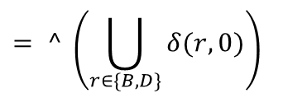
δ*
0
C
0
0
1
A
^
B
^
D
$$δ^{∗}\left(A,010\right)= ^ \left(\bigcup_{r∈δ^{∗}(A,01)}{δ(r,0)}\right)$$
$$= ^ \left(\bigcup_{r∈\{B,D\}}{δ(r,0)}\right)$$
$$= ^ \left(δ\left(B,0\right)∪δ\left(D,0\right)\right)$$
$$= ^ \left(\{C,D\}\right)$$
$$=\{C,D\}$$
Final answer
$$δ^{∗}\left(A,01\right)= ^ \left(\bigcup_{r∈δ^{∗}(A,0)}{δ(r,1)}\right)$$
$$= ^ \left(\bigcup_{r∈\{A,B,C,D\}}{δ(r,1)}\right)$$
$$= ^ \left(\begin{aligned}δ\left(A,1\right)∪δ\left(B,1\right)∪δ\left(C,1\right) \\ ∪δ\left(D,1\right)\end{aligned}\right)$$
$$= ^ \left(\{B\}\right)$$
$$=\{B,D\}$$
$$δ^{∗}\left(A,0\right)= ^ \left(\bigcup_{r∈δ^{∗}(A,^)}{δ(r,0)}\right)$$
$$= ^ \left(\bigcup_{r∈\{A,B,D\}}{δ(r,0)}\right)$$
$$= ^ \left(δ\left(A,0\right)∪ δ\left(B,0\right)∪ δ\left(D,0\right)\right)$$
$$= ^ \left(\{A,C,D\}\right)$$
$$=\{A,B,C,D\}$$
$$δ^{∗}\left(A,^\right)= ^ \left(\{A\}\right)$$
$=${A , B , D}

Slide 103
Theorem - 6
If L ⊆ ∑* is a language that is accepted by the NFA-ʌ M=( Q , ∑ , q₀ , A , δ ) then there is an NFA M₁=(Q₁, ∑ , q₁ , A₁, δ₁ ) that also accepts L

Slide 104
Theorem - 7
For any alphabet ∑, and any language L ⊂ ∑* these three statements are equivalent:
  L can be recognized by an FA
  L can be recognized by an NFA
  L can be recognized by an NFA-ʌ

Slide 105
Converting NFA-ʌ to NFA
C
0
1
0
B
1
ʌ
A
E
ʌ
D
0
1
NFA-ʌ

Slide 106
Converting NFA-ʌ to NFA
C
Prepare transition table for NFA
Two input symbols 0 and 1
For all states in NFA-ʌ
0
1
0
B
1
ʌ
A
E
 | 0 | 1
A
B
C
D
E
ʌ
D
0
1
NFA-ʌ

Slide 107
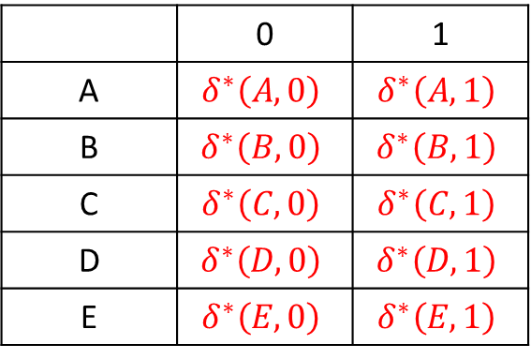
Converting NFA-ʌ to NFA
C
Prepare transition table for NFA
Two input symbols 0 and 1
For all states in NFA-ʌ
0
1
0
B
1
ʌ
A
E
 | 0 | 1
A | $$δ^{∗}\left(A,0\right)$$ | $$δ^{∗}\left(A,1\right)$$
B | $$δ^{∗}\left(B,0\right)$$ | $$δ^{∗}\left(B,1\right)$$
C | $$δ^{∗}\left(C,0\right)$$ | $$δ^{∗}\left(C,1\right)$$
D | $$δ^{∗}\left(D,0\right)$$ | $$δ^{∗}\left(D,1\right)$$
E | $$δ^{∗}\left(E,0\right)$$ | $$δ^{∗}\left(E,1\right)$$
ʌ
D
0
1
NFA-ʌ

Slide 108
Converting NFA-ʌ to NFA
C
Prepare transition table for NFA
Two input symbols 0 and 1
For all states in NFA-ʌ
0
1
0
B
1
ʌ
A
E
 | 0 | 1
A | A,B,C,D,E | D,E
B | C | E
C | - | B
D | E | D
E | - | -
ʌ
D
0
1
NFA-ʌ

Slide 109
Converting NFA-ʌ to NFA
Prepare NFA from
transition table
 | 0 | 1
A | A,B,C,D,E | D,E
B | C | E
C | - | B
D | E | D
E | - | -

Slide 110
Converting NFA-ʌ to NFA
C
Prepare NFA from
transition table
0
0
1
0
B
1
0
A
0,1
E
 | 0 | 1
A | A,B,C,D,E | D,E
B | C | E
C | - | B
D | E | D
E | - | -
0,1
D
0
1
NFA

Slide 111
Converting NFA-ʌ to DFA
Two method
  NFA-ʌ to NFA then NFA to DFA
  NFA-ʌ to DFA

Slide 112
Converting NFA-ʌ to DFA
C
0
1
0
B
1
ʌ
A
E
ʌ
D
0
1
NFA-ʌ

Slide 113
Converting NFA-ʌ to DFA
Prepare transition table for FA
Two input symbols 0 and 1
Start with initial state A
C
0
1
0
 | 0 | 1
A
B
1
ʌ
A
E
ʌ
D
0
1
NFA-ʌ

Slide 114


Converting NFA-ʌ to DFA
C
0
1
0
 | 0 | 1
A | A,B,C,D,E | D,E
B
1
ʌ
A
E
$$δ^{∗}\left(A,0\right)$$
$$δ^{∗}\left(A,1\right)$$
ʌ
D
0
1
NFA-ʌ

Slide 115
Converting NFA-ʌ to DFA
Two new states encounter
A,B,C,D,E and D,E
Add them
C
0
1
0
 | 0 | 1
A | A,B,C,D,E | D,E
A,B,C,D,E
D,E
B
1
ʌ
A
E
ʌ
D
0
1
NFA-ʌ

Slide 116


Converting NFA-ʌ to DFA
C
0
1
0
 | 0 | 1
A | A,B,C,D,E | D,E
A,B,C,D,E | A,B,C,D,E | B,D,E
D,E
B
1
ʌ
A
E
ʌ
D
0
$$δ^{∗}\left(\{A,B,C,D,E\},0\right)$$
1
$$δ^{∗}\left(\{A,B,C,D,E\},1\right)$$
NFA-ʌ

Slide 117
Converting NFA-ʌ to DFA
One new states encounter
B,D,E
Add it
C
0
1
0
 | 0 | 1
A | A,B,C,D,E | D,E
A,B,C,D,E | A,B,C,D,E | B,D,E
D,E
B,D,E
B
1
ʌ
A
E
ʌ
D
0
1
NFA-ʌ

Slide 118


Converting NFA-ʌ to DFA
C
0
1
0
 | 0 | 1
A | A,B,C,D,E | D,E
A,B,C,D,E | A,B,C,D,E | B,E,D
D,E | E | D
B,D,E
B
1
ʌ
A
E
ʌ
D
0
$$δ^{∗}\left(\{D,E\},0\right)$$
1
$$δ^{∗}\left(\{D,E\},1\right)$$
NFA-ʌ

Slide 119
Converting NFA-ʌ to DFA
Two new states encounter
E and D
Add them
C
0
1
0
 | 0 | 1
A | A,B,C,D,E | D,E
A,B,C,D,E | A,B,C,D,E | B,D,E
D,E | E | D
B,D,E
E
D
B
1
ʌ
A
E
ʌ
D
0
1
NFA-ʌ

Slide 120


Converting NFA-ʌ to DFA
C
0
1
0
 | 0 | 1
A | A,B,C,D,E | D,E
A,B,C,D,E | A,B,C,D,E | B,D,E
D,E | E | D
B,D,E | C,E | D,E
E
D
B
1
ʌ
A
E
ʌ
D
0
1
$$δ^{∗}\left(\{B,D,E\},0\right)$$
NFA-ʌ
$$δ^{∗}\left(\{B,D,E\},1\right)$$

Slide 121
Converting NFA-ʌ to DFA
One new states encounter
C,E
Add it
C
0
1
0
 | 0 | 1
A | A,B,C,D,E | D,E
A,B,C,D,E | A,B,C,D,E | B,D,E
D,E | E | D
B,D,E | C,E | D,E
E
D
C,E
B
1
ʌ
A
E
ʌ
D
0
1
NFA-ʌ

Slide 122


Converting NFA-ʌ to DFA
C
0
1
0
 | 0 | 1
A | A,B,C,D,E | D,E
A,B,C,D,E | A,B,C,D,E | B,D,E
D,E | E | D
B,D,E | C,E | D,E
E | ∅ | ∅
D
C,E
B
1
ʌ
A
E
ʌ
D
0
1
NFA-ʌ
$$δ^{∗}\left(E,0\right)$$
$$δ^{∗}\left(E,1\right)$$

Slide 123
Converting NFA-ʌ to DFA
One new states encounter ∅
Add it
C
0
1
0
 | 0 | 1
A | A,B,C,D,E | D,E
A,B,C,D,E | A,B,C,D,E | B,D,E
D,E | E | D
B,D,E | C,E | D,E
E | ∅ | ∅
D
C,E
∅
B
1
ʌ
A
E
ʌ
D
0
1
NFA-ʌ

Slide 124


Converting NFA-ʌ to DFA
C
0
1
0
 | 0 | 1
A | A,B,C,D,E | D,E
A,B,C,D,E | A,B,C,D,E | B,D,E
D,E | E | D
B,D,E | C,E | D,E
E | ∅ | ∅
D | E | D
C,E
∅
B
1
ʌ
A
E
ʌ
D
0
1
NFA-ʌ
$$δ^{∗}\left(D,0\right)$$
$$δ^{∗}\left(D,1\right)$$

Slide 125


Converting NFA-ʌ to DFA
C
0
1
0
 | 0 | 1
A | A,B,C,D,E | D,E
A,B,C,D,E | A,B,C,D,E | B,D,E
D,E | E | D
B,D,E | C,E | D,E
E | ∅ | ∅
D | E | D
C,E | ∅ | B
∅
B
1
ʌ
A
E
ʌ
D
0
1
NFA-ʌ
$$δ^{∗}\left(\{C,E\},0\right)$$
$$δ^{∗}\left(\{C,E\},1\right)$$

Slide 126
Converting NFA-ʌ to DFA
One new states encounter B
Add it
C
0
1
0
 | 0 | 1
A | A,B,C,D,E | D,E
A,B,C,D,E | A,B,C,D,E | B,D,E
D,E | E | D
B,D,E | C,E | D,E
E | ∅ | ∅
D | E | D
C,E | ∅ | B
∅
B
B
1
ʌ
A
E
ʌ
D
0
1
NFA-ʌ

Slide 127


Converting NFA-ʌ to DFA
C
0
1
0
 | 0 | 1
A | A,B,C,D,E | D,E
A,B,C,D,E | A,B,C,D,E | B,D,E
D,E | E | D
B,D,E | C,E | D,E
E | ∅ | ∅
D | E | D
C,E | ∅ | B
∅ | ∅ | ∅
B
B
1
ʌ
A
E
ʌ
D
0
1
NFA-ʌ
$$δ^{∗}\left(\text{∅} ,0\right)$$
$$δ^{∗}\left(\text{∅} ,1\right)$$

Slide 128


Converting NFA-ʌ to DFA
C
0
1
0
 | 0 | 1
A | A,B,C,D,E | D,E
A,B,C,D,E | A,B,C,D,E | B,D,E
D,E | E | D
B,D,E | C,E | D,E
E | ∅ | ∅
D | E | D
C,E | ∅ | B
∅ | ∅ | ∅
B | C | ∅
B
1
ʌ
A
E
ʌ
D
0
1
NFA-ʌ
$$δ^{∗}\left(\text{B} ,0\right)$$
$$δ^{∗}\left(\text{B} ,1\right)$$

Slide 129
Converting NFA-ʌ to DFA
One new state encounter
C process them
C
0
1
0
 | 0 | 1
A | A,B,C,D,E | D,E
A,B,C,D,E | A,B,C,D,E | B,D,E
D,E | E | D
B,D,E | C,E | D,E
E | ∅ | ∅
D | E | D
C,E | ∅ | B
∅ | ∅ | ∅
B | C | ∅
C | ∅ | B
B
1
ʌ
A
E
ʌ
D
0
1
NFA-ʌ

Slide 130
Converting NFA-ʌ to DFA
One new state encounter
C process them
C
0
1
0
 | 0 | 1
A | A,B,C,D,E | D,E
A,B,C,D,E | A,B,C,D,E | B,D,E
D,E | E | D
B,D,E | C,E | D,E
E | ∅ | ∅
D | E | D
C,E | ∅ | B
∅ | ∅ | ∅
B | C | ∅
C
B
1
ʌ
A
E
ʌ
D
0
1
NFA-ʌ

Slide 131


Converting NFA-ʌ to DFA
C
0
1
0
 | 0 | 1
A | A,B,C,D,E | D,E
A,B,C,D,E | A,B,C,D,E | B,D,E
D,E | E | D
B,D,E | C,E | D,E
E | ∅ | ∅
D | E | D
C,E | ∅ | B
∅ | ∅ | ∅
B | C | ∅
C | ∅ | B
B
1
ʌ
A
E
ʌ
D
0
1
$$δ^{∗}\left(\text{C} ,1\right)$$
NFA-ʌ
$$δ^{∗}\left(\text{C} ,0\right)$$

Slide 132
Converting NFA-ʌ to DFA
No new state encounter
So stop & prepare FA for it
C
0
1
0
 | 0 | 1
A | A,B,C,D,E | D,E
A,B,C,D,E | A,B,C,D,E | B,D,E
D,E | E | D
B,D,E | C,E | D,E
E | ∅ | ∅
D | E | D
C,E | ∅ | B
∅ | ∅ | ∅
B | C | ∅
C | ∅ | B
B
1
ʌ
A
E
ʌ
D
0
1
NFA-ʌ

Slide 133
Converting NFA-ʌ to DFA
0
ABCDE
CE
1
0
BDE
 | 0 | 1
A | A,B,C,D,E | D,E
A,B,C,D,E | A,B,C,D,E | B,D,E
D,E | E | D
B,D,E | C,E | D,E
E | ∅ | ∅
D | E | D
C,E | ∅ | B
∅ | ∅ | ∅
B | C | ∅
C | ∅ | B
0
0
1
A
1
∅
0
C
1
0,1
0
0,1
1
DE
0
E
B
1
1
0
D
1

Slide 134
Converting NFA-ʌ to DFA
0
ABCDE
CE
1
0
Initial state of NFA
will be the
initial state for FA
So A will be
the initial state
0
BDE
0
1
A
1
∅
0
C
1
0,1
0
0,1
1
DE
0
E
B
1
1
0
D
1

Slide 135
Converting NFA-ʌ to DFA
0
ABCDE
CE
1
0
Accepting states of
NFA was E
All states of FA
Containing E will be
the accepting state
So ABCDE , BDE , CE ,
DE , E will be the
accepting states
0
BDE
0
1
A
1
∅
0
C
1
0,1
0
0,1
1
DE
0
E
B
1
1
0
D
1

Slide 136
Converting NFA-ʌ to DFA
0
ABCDE
CE
1
0
0
BDE
0
1
A
1
∅
0
C
1
0,1
0
0,1
1
DE
0
E
B
1
1
0
DFA
D
1

Slide 137
Kleene’s theorem (part-1)
Any regular language can be accepted by a finite automaton

Slide 138
Kleene’s theorem (part-1)
  From theorem-7 all regular languages are accepted by NFA-ʌ
  Let L₁ and L₂ be the regular languages and accepted by NFA-ʌ M₁ and M₂ respectively
f1
f2
M₁
q1
q2
M₂
f1’
f2’

Slide 139
Kleene’s theorem (part-1)
  From L₁ and L₂ tree other regular languages can be generated
    L₁ ∪ L₂
    L₁L₂
    L₁*
  Let their respective NFA-ʌ are
    M_{u}
    M_{c}
    M_{k}

Slide 140
Kleene’s theorem (part-1)
  Construction of M_{u} = ( Q_{u} , ∑ , q_{u} , A_{u} , δ_{u} )
    Q_{u} = Q₁ ∪ Q₂ ∪ {q_{u}}
    A_{u} = A₁ ∪ A₂
    δ_{u} ( q_{u} , ʌ ) = { q₁ , q₂ }
f1
q1
ʌ
f1’
qu
f2
ʌ
q2
f2’
L₁ ∪ L₂

Slide 141
Kleene’s theorem (part-1)
  Construction of M_{c} = ( Q_{c} , ∑ , q_{c} , A_{c} , δ_{c} )
    Q_{c} = Q₁ ∪ Q₂
    q_{c} = q₁
    A_{c} = A₂
    δ_{c} ( A₁ , ʌ ) = { q₂ }
L₁L₂
f1
f1
ʌ
f2
qc = q1
q1
q2
f1’
f1’
ʌ
f2’

Slide 142
Kleene’s theorem (part-1)
  Construction of M_{k} = ( Q_{k} , ∑ , q_{k} , A_{k} , δ_{k} )
    Q_{k} = Q₁ ∪ { q_{k} }
    A_{c} = { q_{k} }
    δ_{k} ( A₁ , ʌ ) = { q_{k} }
    δ_{k} ( q_{k} , ʌ ) = { q₁ }
L₁*
ʌ
f1
f1
qk
ʌ
q1
f1’
f1’
ʌ

Slide 143
RE to NFA-ʌ using Kleene’s theorem
( 00 + 1 ) * ( 10 ) *
∑ = {0,1}
So prepare NFA-ʌ for 0 and 1
0
1

Slide 144
RE to NFA-ʌ using Kleene’s theorem
( 00 | 1 ) * ( 10 ) *
0
0

Slide 145
RE to NFA-ʌ using Kleene’s theorem
( 00 | 1 ) * ( 10 ) *
0
ʌ
0

Slide 146
RE to NFA-ʌ using Kleene’s theorem
( 00 | 1 ) * ( 10 ) *
0
ʌ
0
1

Slide 147
RE to NFA-ʌ using Kleene’s theorem
( 00 | 1 ) * ( 10 ) *
0
ʌ
0
ʌ
1
ʌ

Slide 148
RE to NFA-ʌ using Kleene’s theorem
( 00 | 1 ) * ( 10 ) *
ʌ
0
ʌ
0
ʌ
ʌ
1
ʌ
ʌ

Slide 149
RE to NFA-ʌ using Kleene’s theorem
( 00 | 1 ) * ( 10 ) *
ʌ
0
ʌ
0
ʌ
ʌ
1
ʌ
ʌ

Slide 150
RE to NFA-ʌ using Kleene’s theorem
( 00 | 1 ) * ( 10 ) *
ʌ
0
ʌ
0
ʌ
ʌ
1
ʌ
ʌ
1
0

Slide 151
RE to NFA-ʌ using Kleene’s theorem
( 00 | 1 ) * ( 10 ) *
ʌ
0
ʌ
0
ʌ
ʌ
1
ʌ
ʌ
1
ʌ
0

Slide 152
RE to NFA-ʌ using Kleene’s theorem
( 00 | 1 ) * ( 10 ) *
ʌ
0
ʌ
0
ʌ
ʌ
1
ʌ
ʌ
ʌ
1
ʌ
0
ʌ

Slide 153
RE to NFA-ʌ using Kleene’s theorem
( 00 | 1 ) * ( 10 ) *
ʌ
0
ʌ
0
ʌ
ʌ
1
ʌ
ʌ
ʌ
1
ʌ
0
ʌ

Slide 154
RE to NFA-ʌ using Kleene’s theorem
( 00 | 1 ) * ( 10 ) *
ʌ
0
ʌ
0
ʌ
ʌ
1
ʌ
ʌ
ʌ
ʌ
1
ʌ
0
ʌ

Slide 155
RE to NFA-ʌ using Kleene’s theorem
( 00 | 1 ) * ( 10 ) *
ʌ
0
ʌ
0
ʌ
ʌ
1
ʌ
ʌ
ʌ
ʌ
1
ʌ
0
ʌ

Slide 156
Example-1
( a | b )*
ʌ
a
ʌ
ʌ
ʌ
b
ʌ

Slide 157
Example-2
a* | b*
ʌ
ʌ
a
ʌ
ʌ
ʌ
b
ʌ

Slide 158
Example-3
( a* | b )* c a*
ʌ
ʌ
a
ʌ
ʌ
ʌ
c
ʌ
ʌ
a
ʌ
b
ʌ

Slide 159
Example-4
ʌ
( a | b )* c* d
a
ʌ
ʌ
ʌ
b
ʌ
ʌ
ʌ
ʌ
c
d
ʌ

Slide 160
Example-5
a* b a
ʌ
ʌ
a
b
ʌ
a
ʌ

Slide 161
Example-6
a⁺ b* ( c | d )
ʌ
a
ʌ
ʌ
a
ʌ
ʌ
ʌ
b
c
ʌ
ʌ
ʌ
d

Slide 162
Example-7
a⁺ b ( c | d ) a * b
ʌ
a
ʌ
ʌ
a
ʌ
c
ʌ
ʌ
ʌ
b
ʌ
ʌ
a
ʌ
ʌ
d
ʌ
b

Slide 163
Example-8
( ( a* b* ) c )* a⁺
ʌ
ʌ
ʌ
ʌ
ʌ
a
ʌ
b
c
ʌ
ʌ
ʌ
ʌ
a
ʌ
ʌ
a

Slide 164
MINIMIZING
FA
(using tabular method)

Slide 165
Example - 1
0
0
4
Total states are 7
Write
1 to 6 horizontally
And
2 to 7 vertically
2
1
0
0
1
5
1
0
1
1
0
6
1
3
0
2
3
4
5
6
7
 | 1 | 2 | 3 | 4 | 5 | 6
1
7
1

Slide 166
Example - 1
0
0
4
Draw table like below
2
1
0
0
1
5
1
0
1
1
0
6
1
3
0
2
3
4
5
6
7
 | 1 | 2 | 3 | 4 | 5 | 6
1
7
1

Slide 167
Example - 1
0
0
4
Pass – 1
-----------------------------------------------------------------------------
Accepting state is 6
Write in rows & column of 6
2
1
0
0
1
5
1
0
1
1
0
6
1
3
0
2
3
4
5
6 | 1 | 1 | 1 | 1 | 1
7 |  |  |  |  |  | 1
 | 1 | 2 | 3 | 4 | 5 | 6
1
7
1

Slide 168
Example - 1
0
0
4
Pass – 2
-----------------------------------------------------------------------------
Try to fill other blank cells
2
1
0
0
1
5
1
0
1
1
0
6
1
3
0
2
3
4
5
6 | 1 | 1 | 1 | 1 | 1
7 |  |  |  |  |  | 1
 | 1 | 2 | 3 | 4 | 5 | 6
1
7
1

Slide 169
Example - 1
0
0
4
Pass – 2
-----------------------------------------------------------------------------
Try to fill other black cells
2
1
0
0
1
5
1
0
1
1
0
6
1
3
0
2
3
4
5
6 | 1 | 1 | 1 | 1 | 1
7 | 2 |  |  |  |  | 1
 | 1 | 2 | 3 | 4 | 5 | 6
1
7
Select 1,7 cell
1 → (0) → 2
7 → (0) → 6
2,6 is marked so mark 1,7 with pass-2
1

Slide 170
Example - 1
0
0
4
Pass – 2
-----------------------------------------------------------------------------
Try to fill other black cells
2
1
0
0
1
5
1
0
1
1
0
6
1
3
0
2
3
4
5
6 | 1 | 1 | 1 | 1 | 1
7 | 2 | 2 |  |  |  | 1
 | 1 | 2 | 3 | 4 | 5 | 6
1
7
Select 2,7 cell
2 → (0) → 4
7 → (0) → 6
4,6 is marked so mark 2,7 with pass-2
1

Slide 171
Example - 1
0
0
4
Pass – 2
-----------------------------------------------------------------------------
Try to fill other black cells
2
1
0
0
1
5
1
0
1
1
0
6
1
3
0
2
3
4
5
6 | 1 | 1 | 1 | 1 | 1
7 | 2 | 2 |  |  |  | 1
 | 1 | 2 | 3 | 4 | 5 | 6
1
7
Select 3,7 cell
3 → (0) → 6
7 → (0) → 6
6,6 not there try fro input (1)
1

Slide 172
Example - 1
0
0
4
Pass – 2
-----------------------------------------------------------------------------
Try to fill other black cells
2
1
0
0
1
5
1
0
1
1
0
6
1
3
0
2
3
4
5
6 | 1 | 1 | 1 | 1 | 1
7 | 2 | 2 |  |  |  | 1
 | 1 | 2 | 3 | 4 | 5 | 6
1
7
Select 3,7 cell
3 → (1) → 7
7 → (1) → 7
7,7 not there so 3,7 cannot be marked
1

Slide 173
Example - 1
0
0
4
Pass – 2
-----------------------------------------------------------------------------
Try to fill other black cells
2
1
0
0
1
5
1
0
1
1
0
6
1
3
0
2
3
4
5
6 | 1 | 1 | 1 | 1 | 1
7 | 2 | 2 |  | 2 |  | 1
 | 1 | 2 | 3 | 4 | 5 | 6
1
7
Select 4,7 cell
4 → (0) → 4
7 → (0) → 6
4,6 is marked so mark 4,7 with pass-2
1

Slide 174
Example - 1
0
0
4
Pass – 2
-----------------------------------------------------------------------------
Try to fill other black cells
2
1
0
0
1
5
1
0
1
1
0
6
1
3
0
2
3
4
5
6 | 1 | 1 | 1 | 1 | 1
7 | 2 | 2 |  | 2 |  | 1
 | 1 | 2 | 3 | 4 | 5 | 6
1
7
Select 5,7 cell
5 → (0) → 6
7 → (0) → 6
6,6 not there try fro input (1)
1

Slide 175
Example - 1
0
0
4
Pass – 2
-----------------------------------------------------------------------------
Try to fill other black cells
2
1
0
0
1
5
1
0
1
1
0
6
1
3
0
2
3
4
5
6 | 1 | 1 | 1 | 1 | 1
7 | 2 | 2 |  | 2 |  | 1
 | 1 | 2 | 3 | 4 | 5 | 6
1
7
Select 5,7 cell
5 → (1) → 7
7 → (1) → 7
7,7 not there so 5,7 cannot be marked
1

Slide 176
Example - 1
0
0
4
Pass – 2
-----------------------------------------------------------------------------
After completing pass-2
Some cells are marked with 2
Some cells are still blank
Go for Pass-3
2
1
0
0
1
5
1
0
1
1
0
6
1
3
0
2
3 | 2 | 2
4 |  |  | 2
5 | 2 | 2 |  | 2
6 | 1 | 1 | 1 | 1 | 1
7 | 2 | 2 |  | 2 |  | 1
 | 1 | 2 | 3 | 4 | 5 | 6
1
7
1

Slide 177
Example - 1
0
0
4
Pass – 3
-----------------------------------------------------------------------------
Follow the same process of
pass-2 to mark
In this pass cell will be
marked with 3
2
1
0
0
1
5
1
0
1
1
0
6
1
3
0
2
3 | 2 | 2
4 |  |  | 2
5 | 2 | 2 |  | 2
6 | 1 | 1 | 1 | 1 | 1
7 | 2 | 2 |  | 2 |  | 1
 | 1 | 2 | 3 | 4 | 5 | 6
1
7
1

Slide 178
Example - 1
0
0
4
Pass – 3
-----------------------------------------------------------------------------
But no cell is marked
in this pass
now STOP
2
1
0
0
1
5
1
0
1
1
0
6
1
3
0
2
3 | 2 | 2
4 |  |  | 2
5 | 2 | 2 |  | 2
6 | 1 | 1 | 1 | 1 | 1
7 | 2 | 2 |  | 2 |  | 1
 | 1 | 2 | 3 | 4 | 5 | 6
1
7
1

Slide 179
Example - 1
Prepare states for
P0 (initial state)
P1 – Pn (for all full rows)
2
3 | 2 | 2
4 |  |  | 2
5 | 2 | 2 |  | 2
6 | 1 | 1 | 1 | 1 | 1
7 | 2 | 2 |  | 2 |  | 1
 | 1 | 2 | 3 | 4 | 5 | 6

Slide 180
Example - 1
Prepare states for
P0 (initial state)
P1 – Pn (for all full rows)
P0 = 1
P1 = 3
P2 = 6
2
3 | 2 | 2
4 |  |  | 2
5 | 2 | 2 |  | 2
6 | 1 | 1 | 1 | 1 | 1
7 | 2 | 2 |  | 2 |  | 1
 | 1 | 2 | 3 | 4 | 5 | 6

Slide 181
Example - 1
Assign row numbers to
any set (P0 to P2) according
to there empty cell
P0 = 1
P1 = 3
P2 = 6
2
3 | 2 | 2
4 |  |  | 2
5 | 2 | 2 |  | 2
6 | 1 | 1 | 1 | 1 | 1
7 | 2 | 2 |  | 2 |  | 1
 | 1 | 2 | 3 | 4 | 5 | 6

Slide 182
Example - 1
row-2 is empty in column-1
So keep 2 with 1 in P0
P0 = 1 , 2
P1 = 3
P2 = 6
2
3 | 2 | 2
4 |  |  | 2
5 | 2 | 2 |  | 2
6 | 1 | 1 | 1 | 1 | 1
7 | 2 | 2 |  | 2 |  | 1
 | 1 | 2 | 3 | 4 | 5 | 6

Slide 183
Example - 1
row-4 is empty in
column-1 and 2
So keep 4 with 1 and 2 in P0
P0 = 1 , 2 , 4
P1 = 3
P2 = 6
2
3 | 2 | 2
4 |  |  | 2
5 | 2 | 2 |  | 2
6 | 1 | 1 | 1 | 1 | 1
7 | 2 | 2 |  | 2 |  | 1
 | 1 | 2 | 3 | 4 | 5 | 6

Slide 184
Example - 1
row-5 is empty in column-3
So keep 5 with 3 in P1
P0 = 1 , 2 , 4
P1 = 3 , 5
P2 = 6
2
3 | 2 | 2
4 |  |  | 2
5 | 2 | 2 |  | 2
6 | 1 | 1 | 1 | 1 | 1
7 | 2 | 2 |  | 2 |  | 1
 | 1 | 2 | 3 | 4 | 5 | 6

Slide 185
Example - 1
row-7 is empty
in column-3 and 5
So keep 7 with 3 and 5 in P1
P0 = 1 , 2 , 4
P1 = 3 , 5 , 7
P2 = 6
2
3 | 2 | 2
4 |  |  | 2
5 | 2 | 2 |  | 2
6 | 1 | 1 | 1 | 1 | 1
7 | 2 | 2 |  | 2 |  | 1
 | 1 | 2 | 3 | 4 | 5 | 6

Slide 186
Example - 1
Construct Minimized FA with
three states P0 , P1 , P2
Draw transitions
from original FA
P0 = 1 , 2 , 4
P1 = 3 , 5 , 7
P2 = 6
0
1
P0
1
P1
0
P2
1
0

Slide 187
Example - 1
In original FA
1 is initial state
which is there in P0
so P0 will be the initial state
In minimized FA
P0 = 1 , 2 , 4
P1 = 3 , 5 , 7
P2 = 6
0
1
P0
1
P1
0
P2
1
0

Slide 188
Example - 1
In original FA
6 is accepting state
which there in P2
so P2 will be the accepting
State in minimized FA
P0 = 1 , 2 , 4
P1 = 3 , 5 , 7
P2 = 6
0
1
P0
1
P1
0
P2
1
0

Slide 189
Example - 2
P0 = 1
P1 = 2
P2 = 3 , 5
P3 = 4 , 6
P4 = 7
a
2 | 2
3 | 2 | 2
4 | 1 | 1 | 1
5 | 2 | 2 |  | 1
6 | 1 | 1 | 1 |  | 1
7 | 1 | 1 | 1 | 2 | 1 | 2
 | 1 | 2 | 3 | 4 | 5 | 6
a
4
2
b
a
a
b
5
1
a
b
b
a
6
b
3
a
b
7
P1
a,b
a
b
P0
P2
b
b
b
b
P4
P3
a
a

Slide 190
Example - 3
2
b
a
2 | 2
3 |  | 2
4 | 2 |  | 2
5 | 1 | 1 | 1 | 1
 | 1 | 2 | 3 | 4
b
a
1
5
a
b
b
3
a
4
P0 = 1 , 3
P1 = 2 , 4
P2 = 5
b
a
b
b
P0
a
P1
b
P2
a
a

Slide 191
Example - 4
a
2
a
2 | 3
3 | 1 | 1
4 | 2 | 2 | 1
5 | 2 | 2 | 1 | 2
6 | 1 | 1 | 3 | 1 | 1
 | 1 | 2 | 3 | 4 | 5
a
b
1
3
b
b
b
6
b
4
a
a
a
5
b
There is no empty cell in table
So given FA is already minimized

Slide 192
Example - 5
3
a
b
b
b
1
a
2
a
4
a
5
a
6
b
a
b
2 | 1
3 | 2 | 1
4 | 2 | 1 | 2
5 | 1 | 2 | 1 | 1
6 | 2 | 1 | 3 | 2 | 1
 | 1 | 2 | 3 | 4 | 5
There is no empty cell in table
So given FA is already minimized

Slide 193
Example - 6
a
2 | 2
3 | 2 | 2
4 | 2 | 2 | 2
5 | 2 | 2 | 2
6 | 1 | 1 | 1 | 1 | 1
7 | 1 | 1 | 1 | 1 | 1
 | 1 | 2 | 3 | 4 | 5 | 6
2
b
a
b
b
1
b
6
a
3
a
7
a
a
b
a
4
5
b
b
P1
a
P0
a
P0 = 1
P1 = 2
P2 = 3
P3 = 4 , 5
P4 = 6 , 7
a
P2
b
a
b
P4
b
a
P3
b
b

Slide 194
Example - 7
b
a
4
2 | 2
3 | 1 | 1
4 | 1 | 1 | 2
5 | 1 | 1 | 2 | 2
6 | 1 | 1 | 2 | 2 | 2
7 | 3 | 2 | 1 | 1 | 1 | 1
 | 1 | 2 | 3 | 4 | 5 | 6
2
a
b
b
a
5
1
a
b
a
b
a
6
3
b
b
7
a
There is no empty cell in table
So given FA is already minimized

Slide 195
MINIMIZING
FA
(using subset method)

Slide 196
Example - 1
2
b
a
b
a
Remove unreachable states
(states not having incoming
transition)
1
5
a
a
b
6
b
b
3
a
4
b
a

Slide 197
Example - 1
2
b
a
b
a
Remove unreachable states
(states not having incoming
transition)
1
5
a
a
b
6
b
b
3
a
4
b
a

Slide 198
Example - 1
2
b
a
b
a
Prepare transition table
1
5
a
b
 | a | b
1 | 2 | 3
2 | 3 | 5
3 | 4 | 3
4 | 3 | 5
5 | 2 | 5
b
3
a
4
b
a

Slide 199
Example - 1
0 equivalent
Make two set
(1) all non accepting states (2) all accepting state
Prepare transition table
[ 1 2 3 4 ] [ 5 ]
 | a | b
1 | 2 | 3
2 | 3 | 5
3 | 4 | 3
4 | 3 | 5
5 | 2 | 5

Slide 200
Example - 1
0 equivalent
[ 1 2 3 4 ] [ 5 ]
Prepare transition table
1 equivalent
 | a | b
1 | 2 | 3
2 | 3 | 5
3 | 4 | 3
4 | 3 | 5
5 | 2 | 5
No need check for set having single element
Set having multiple state, take combo of 2 state
Find next state for one input symbol
If both next states are in same set in 0-equivalent
Then they are in same set in 1-equivalent
Otherwise split then in different state
Do for all combos of states
[ 1 [ 2
[ 5 ]
From 1 and 2 check next state for ‘a’
They are 2 and 3 both are in same set in 0-equivalent
From 1 and 2 check next state for ‘b’
They are 3 and 5 both are in DIFFERENT set in 0-equivalent
So 1 and 2 are in DIFFERENT set in 1-equivalent

Slide 201
Example - 1
0 equivalent
[ 1 2 3 4 ] [ 5 ]
Prepare transition table
1 equivalent
 | a | b
1 | 2 | 3
2 | 3 | 5
3 | 4 | 3
4 | 3 | 5
5 | 2 | 5
No need check for set having single element
Set having multiple state, take combo of 2 state
Find next state for one input symbol
If both next states are in same set in 0-equivalent
Then they are in same set in 1-equivalent
Otherwise split then in different state
Do for all combos of states
[ 1 [ 2
[ 5 ]
They are 3 and 4 both are in same set in 0-equivalent
They are 5 and 3 both are in DIFFERENT set in 0-equivalent
So 2 and 3 are in DIFFERENT set in 1-equivalent

Slide 202
Example - 1
0 equivalent
[ 1 2 3 4 ] [ 5 ]
Prepare transition table
1 equivalent
 | a | b
1 | 2 | 3
2 | 3 | 5
3 | 4 | 3
4 | 3 | 5
5 | 2 | 5
No need check for set having single element
Set having multiple state, take combo of 2 state
Find next state for one input symbol
If both next states are in same set in 0-equivalent
Then they are in same set in 1-equivalent
Otherwise split then in different state
Do for all combos of states
[ 1 [ 2
[ 5 ]
3
They are 2 and 4 both are in same set in 0-equivalent
They are 3 and 3 both are in DIFFERENT set in 0-equivalent
So 1 and 3 are in SAME set in 1-equivalent

Slide 203
Example - 1
0 equivalent
[ 1 2 3 4 ] [ 5 ]
Prepare transition table
1 equivalent
 | a | b
1 | 2 | 3
2 | 3 | 5
3 | 4 | 3
4 | 3 | 5
5 | 2 | 5
No need check for set having single element
Set having multiple state, take combo of 2 state
Find next state for one input symbol
If both next states are in same set in 0-equivalent
Then they are in same set in 1-equivalent
Otherwise split then in different state
Do for all combos of states
]
]
[ 5 ]
[ 1 [ 2
3
4
They are 3 and 3 both are in same set in 0-equivalent
They are 5 and 5 both are in same set in 0-equivalent
So 2 and 4 are in SAME set in 1-equivalent

Slide 204
Example - 1
0 equivalent
[ 1 2 3 4 ] [ 5 ]
Prepare transition table
1 equivalent
 | a | b
1 | 2 | 3
2 | 3 | 5
3 | 4 | 3
4 | 3 | 5
5 | 2 | 5
[ 1 3 ] [ 2 4 ] [ 5 ]
2 equivalent
Follow same process of 1 equivalent
Look at the sets of 1-equivalent
[ 1 3 ] [ 2 4 ] [ 5 ]

Slide 205
Example - 1
0 equivalent
[ 1 2 3 4 ] [ 5 ]
Prepare transition table
1 equivalent
 | a | b
1 | 2 | 3
2 | 3 | 5
3 | 4 | 3
4 | 3 | 5
5 | 2 | 5
[ 1 3 ] [ 2 4 ] [ 5 ]
2 equivalent
[ 1 3 ] [ 2 4 ] [ 5 ]
No change in 1-equivalent and 2-equivalent sets
So stop

Slide 206
Example - 1
0 equivalent
[ 1 2 3 4 ] [ 5 ]
Prepare transition table
1 equivalent
 | a | b
1 | 2 | 3
2 | 3 | 5
3 | 4 | 3
4 | 3 | 5
5 | 2 | 5
[ 1 3 ] [ 2 4 ] [ 5 ]
2 equivalent
[ 1 3 ] [ 2 4 ] [ 5 ]
b
b
Each set is state of minimized DFA
a
b
Do connection from transition table
13
24
5
a
a

Slide 207
Example - 1
0 equivalent
[ 1 2 3 4 ] [ 5 ]
Prepare transition table
1 equivalent
 | a | b
1 | 2 | 3
2 | 3 | 5
3 | 4 | 3
4 | 3 | 5
5 | 2 | 5
[ 1 3 ] [ 2 4 ] [ 5 ]
2 equivalent
[ 1 3 ] [ 2 4 ] [ 5 ]
b
b
1 was initial state
so state contain 1 is initial
5 was accepting state
So state contain 5 is accepting
13
a
24
b
5
a
a

